Slide 1
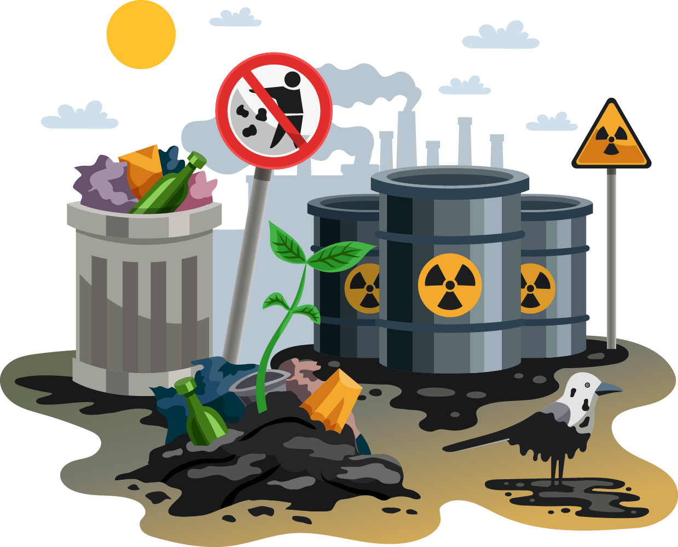
Soil Pollution Prevention Project Proposal
Here is where your presentation begins

Slide 2
Contents of this template
Here’s what you’ll find in this Slidesgo template:
A slide structure based on a project proposal presentation, which you can easily adapt to your needs. For more info on how to edit the template, please visit Slidesgo School or read our FAQs.
To view this template in PowerPoint with the correct fonts, download and install on your computer the fonts that we have used. You can learn how to download and install fonts here.
An assortment of graphic resources that are suitable for use in the presentation can be found in the alternative resources slide.
A thanks slide, which you must keep so that proper credits for our design are given.
A resources slide, where you’ll find links to all the elements used in the template.
Instructions for use.
Final slides with:
The fonts and colors used in the template.
A selection of illustrations. You can also customize and animate them as you wish with the online editor. Visit Storyset to find more.
More infographic resources, whose size and color can be edited.
Sets of customizable icons of the following themes: general, business, avatar, creative process, education, help & support, medical, nature, performing arts, SEO & marketing, and teamwork.
You can delete this slide when you’re done editing the presentation.

Slide 3
Table of contents
01
02
03
About
Requirements
Goals
04
05
06
Sneak peek
The stages
Our team
You can describe the topic of the section here
You can describe the topic of the section here
You can describe the topic of the section here
You can describe the topic of the section here
You can describe the topic of the section here
You can describe the topic of the section here

Slide 4


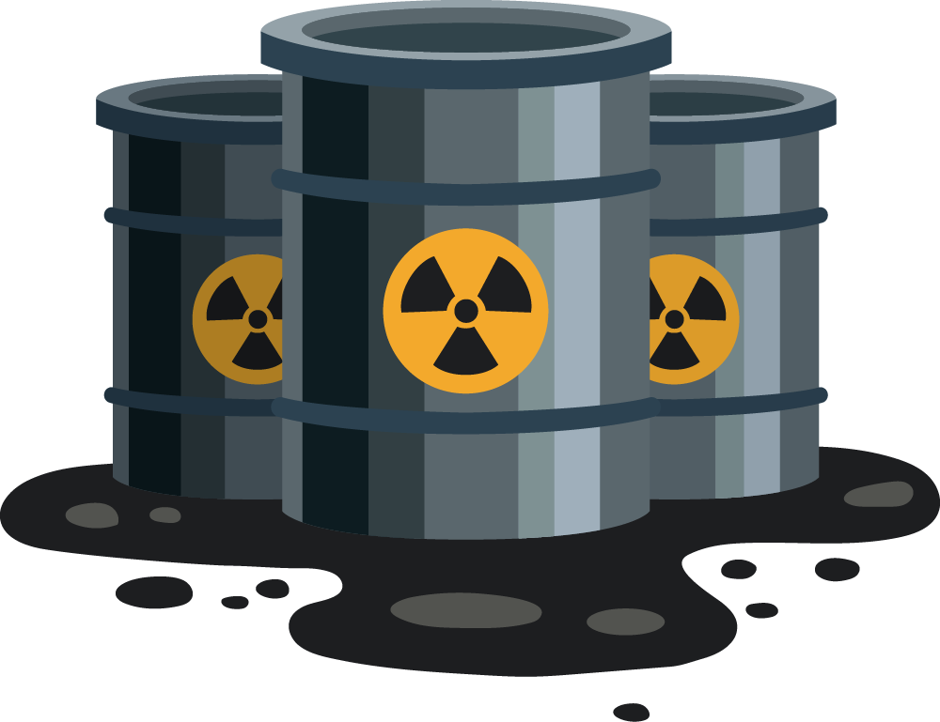
Whoa
This can be the part of the presentation where you introduce yourself, write your email…

Slide 5

01
About
the project
You can enter a subtitle here if you need it

Slide 6
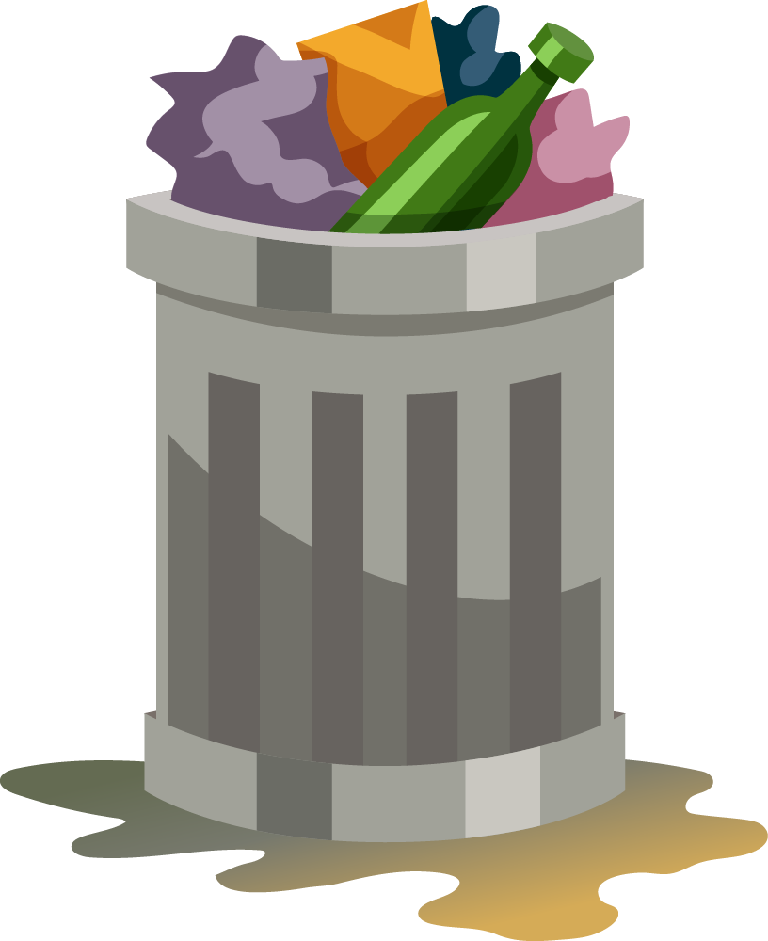
About the project
Do you know what helps you make your point clear?
Lists like this one:
They’re simple
You can organize your ideas clearly
You’ll never forget to buy milk!
And the most important thing: the audience won’t miss the point of your presentation

Slide 7
What we are working on
Mercury
Venus
Mars
It’s the closest planet to the Sun and the smallest of them all
Venus has a beautiful name and is the second planet from the Sun
Despite being red, Mars is a cold place. It’s full of iron oxide dust

Slide 8
Our company
You can give a brief description of the topic you want to talk about here. For example, if you choose to talk about Mercury, you can say that it’s the smallest planet in the entire Solar System

Slide 9
Now
Jupiter is a gas giant and the biggest planet in the Solar System. It's the fourth-brightest object in the night sky. It was named after the Roman god of the skies and lightning

Slide 10
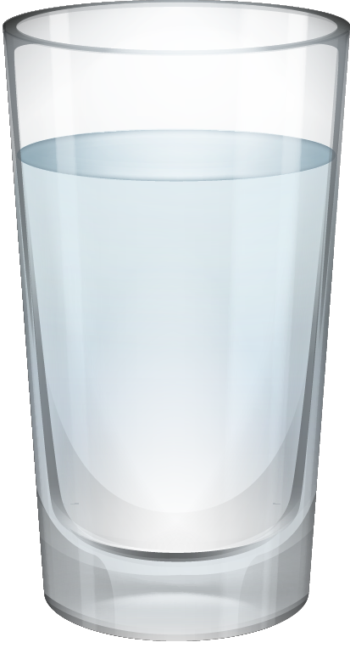
Future
Saturn is a gas giant and has several rings around it. It's composed mostly of hydrogen and helium. This planet was named after the Roman god of wealth and agriculture

Slide 11
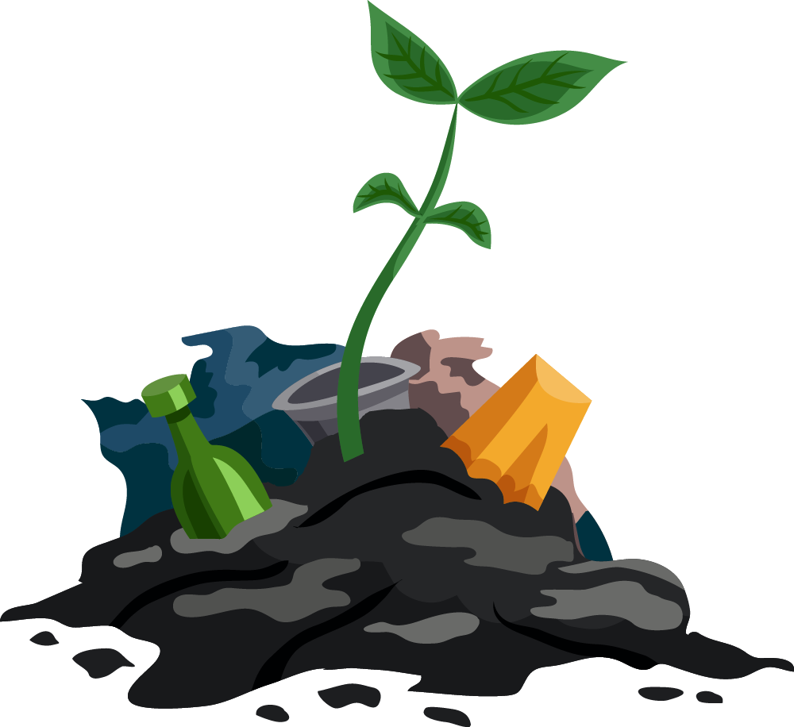
Major requirements
Pollution control
Recycling center
Mercury is the closest planet to the Sun and the smallest one in the Solar System—it’s only a bit larger than the Moon
Venus has a beautiful name and is actually the second planet from the Sun. It’s hot and has a poisonous atmosphere

Slide 12
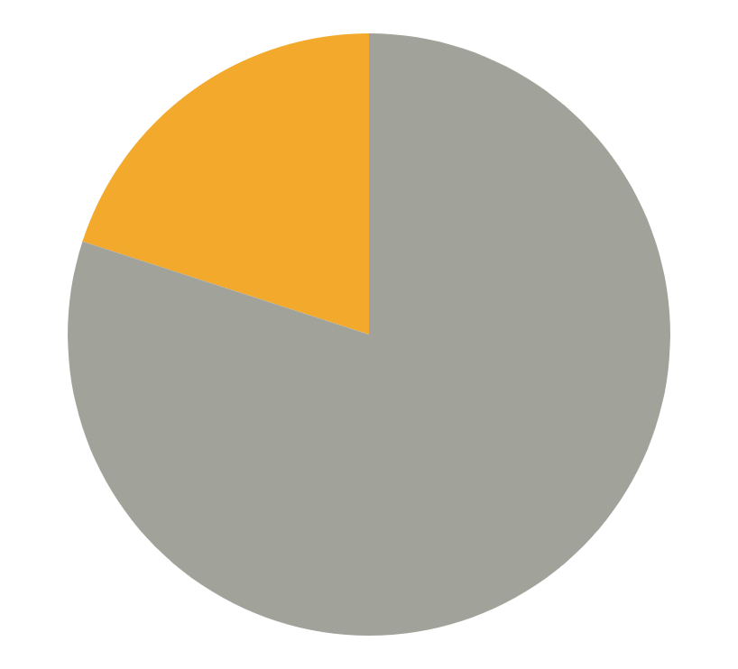
Budget
$20.000
Neptune
$80.000
Mercury
Total
$100.000
Neptune is the farthest planet from the Sun
Mercury is the closest planet to the Sun
Follow the link in the graph to modify its data and then paste the new one here. For more info, click here

Slide 13

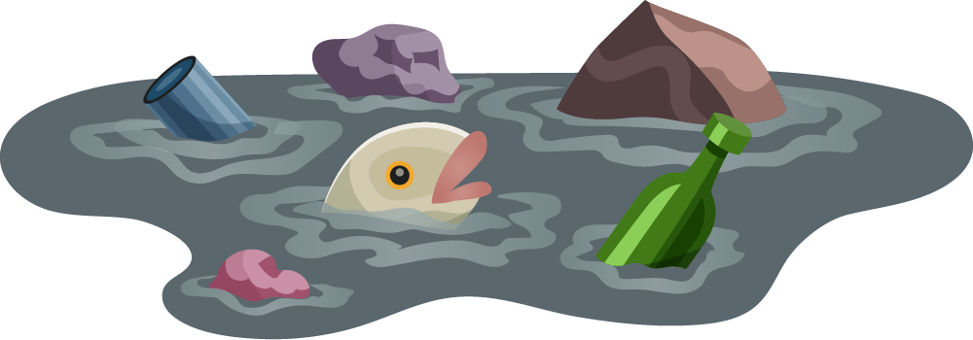
Project goals
Saturn
Mercury
Saturn is a gas giant and has rings
25%
Part 1
Venus
Part 2
75%
Venus is the second planet from the Sun
Mercury is the closest planet to the Sun and the smallest one in the Solar System
Earth is the planet that has life
Pluto is now a dwarf planet

Slide 14
7,498,300
Big numbers catch your audience’s attention

Slide 15
Timeline
2015
2017
2020
2023
Mars
Mercury
Saturn
Venus
Despite being red, Mars is actually a cold place
Mercury is the closest planet to the Sun
Saturn is a gas giant and has several rings
Venus is the second planet from the Sun

Slide 16
386,000 km
333,000,000
9h 55m 23s
Distance between Earth
and the Moon
The Sun’s mass compared to Earth’s
Exact duration of Jupiter’s rotation period

Slide 17

These are
our partners
Partner 1
Partner 3
Partner 2
Partner 4
Mercury is the closest planet to the Sun
Venus is the second planet from the Sun
Jupiter is the biggest planet of them all
Saturn is a gas giant and has rings

Slide 18

—Someone Famous
“This is a quote, words full of wisdom that someone important said and can make the reader get inspired”

Slide 19
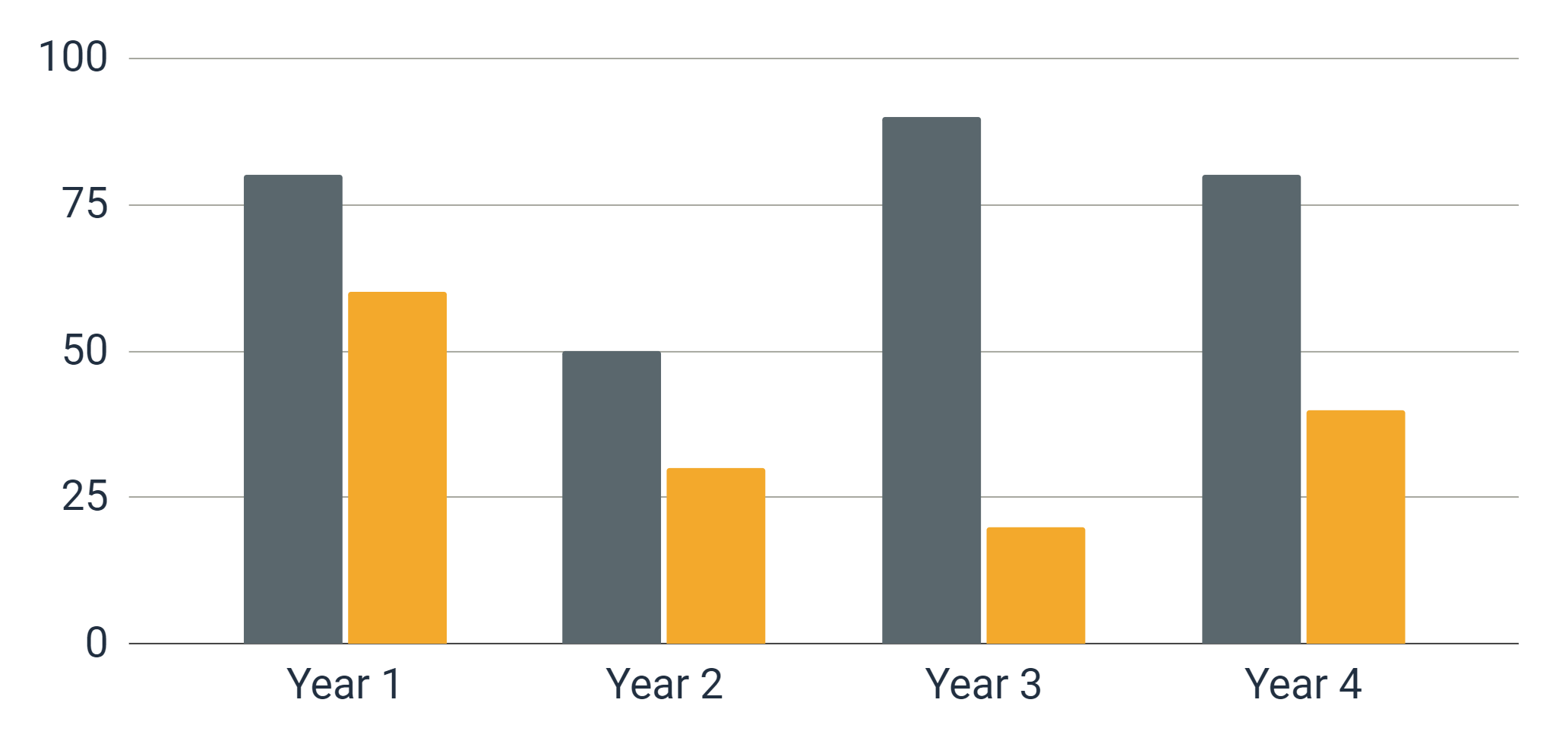
Predicted results
Mercury
Mercury is the closest planet to the Sun
Neptune
Neptune is the farthest planet from the Sun
Follow the link in the graph to modify its data and then paste the new one here. For more info, click here

Slide 20
Project stages
Planning
Budget
Preparation
Execution
Finalization
Maintenance
Mercury is the closest planet to the Sun
Venus is the second planet from the Sun
Despite being red, Mars is a cold place
Jupiter is the biggest planet of them all
Saturn is a gas giant and has rings
Neptune is the farthest planet from the Sun

Slide 21
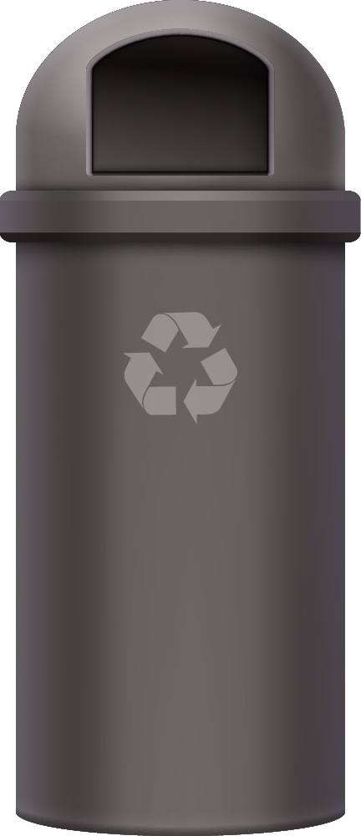
Recycling locations
Venus
Venus is the second planet from the Sun
Earth is the planet that has life
Pluto is now a dwarf planet

Slide 22
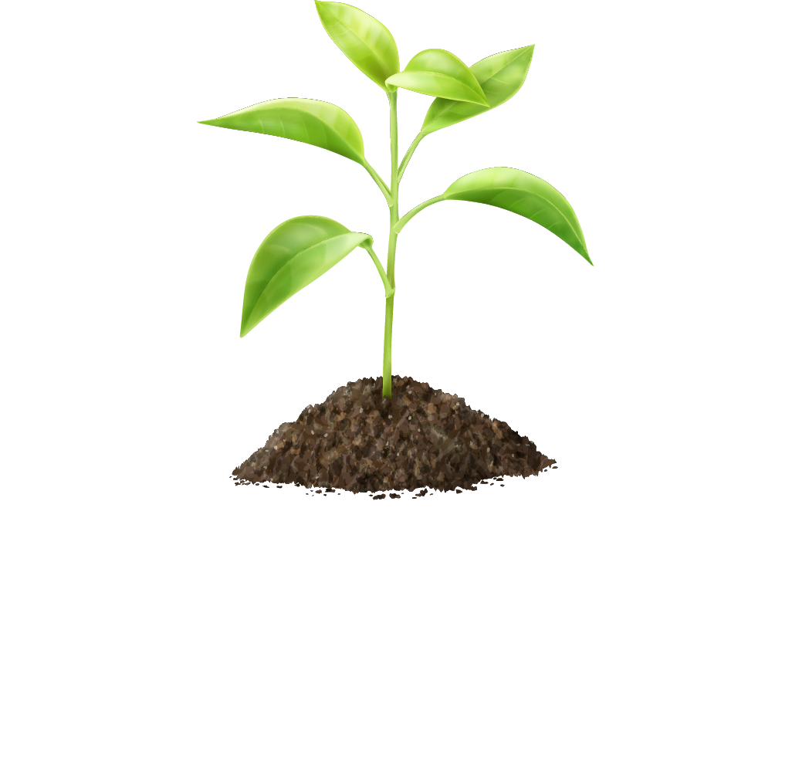
A picture always reinforces the concept
Images reveal large amounts of data, so remember: use an image instead of a long text. Your audience will appreciate it

Slide 23
Project plan
 | Phase 1 | Phase 2
Mercury | Mercury is the closest planet to the Sun | It’s also the smallest planet in the Solar System
Venus | Venus is the second planet from the Sun | It’s terribly hot, even hotter than Mercury
Earth | Earth is the third planet from the Sun | It’s the only one that harbors life in the Solar System

Slide 24
Meet the team
Creative Corey
Awesome Anna
You can explain more about this person here
You can explain more about this person here

Slide 25
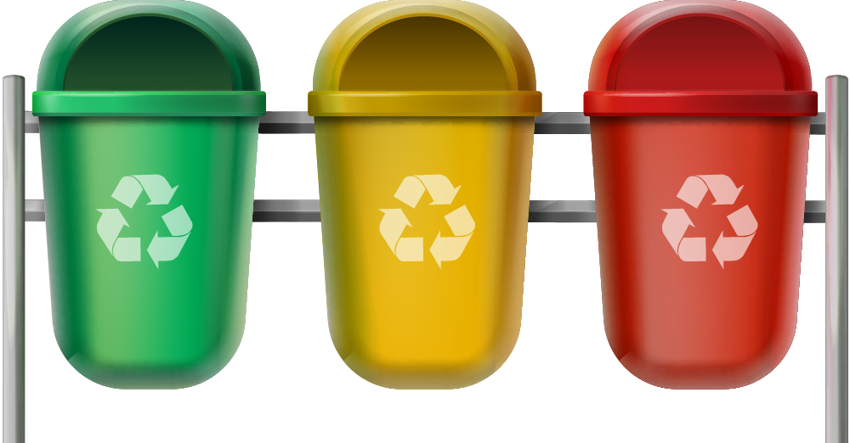

Sneak peek
You can replace the image on the screen with your own work. Just right-click on it and select “Replace image”

Slide 26
Thank you!
Do you have any questions?
youremail@freepik.com
+91 620 421 838
yourwebsite.com
Please keep this slide for attribution

